Slide 1















Software Engineering
Smart printing service for students
Presented by group 02

Slide 2
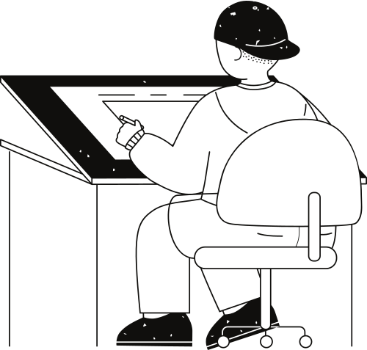




Dương Quang
Minh
Đỗ Hoàng
Quân
Team
members
Hồ Quốc
Đạt
Đỗ Thanh
Liêm
GROUP 02
Đinh Xuân
Quyết

Slide 3
Risks
&
Challenges
Introduce
01
04
Table of contents
Lesson
Learned
Outcomes
02
05
Technical
Decision
03
06
Demo

Slide 4

01
Print document
remotely
Introduce
View printing
status
02
SPSS serve the printing demands of HCMUT students
Review printing history
03

Slide 5
Online cashing using BKPay payment system
04
Introduce
Receive printing report monthly
05

Slide 6
Outcomes
User 1: Students
Login / Logout
View personal printing log
Upload document(s)
Config document
Buy paper(s)
Moderate printing session

Slide 7
Outcomes
User 2: Student Printing Service Officer (SPSO)
Login / Logout
View printing log base on studentID or printerID
Access / Modify document properties
Add / Enable / Disable printer(s)
View annual reports

Slide 8
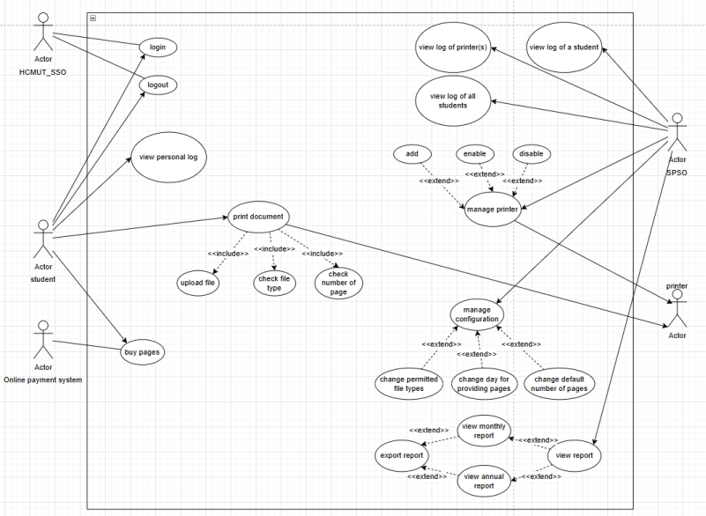
Outcomes
System use case diagram

Slide 9



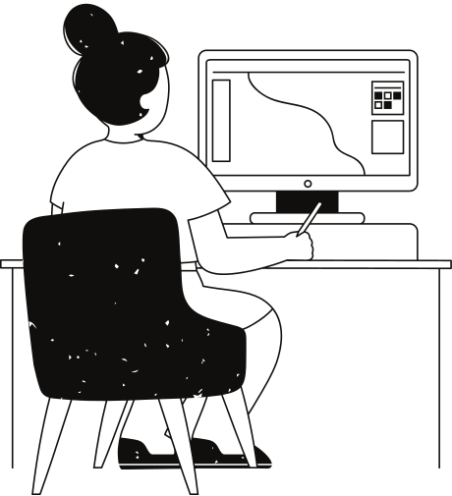


Technical
Decision

Slide 10
Frontend
HTML
CSS
Approach
Intergration
Foundation for website programming
Easy to learn
Can embed many scipting languages like javascript, php, ...

Slide 11
Frontend
php
Approach
Security
Scalability
Intergration
Easy for beginners
C-based programming language
Server-side scripting language
Core system private
Can handle large volumns of traffic
Well compatible with various dbms including MySQL, MongoDB, ...

Slide 12
DBMS
MySQL
Approach
Security
Scalability
Simple syntax
Large supportive community
Patches are update regularly
Offer user authentication, access control and encryption
Works on various OS
Able to support and process very large databases

Slide 13

Risks & Challenges
Ineffective team work
Intergrate API
Online meetings cause
misunderstanding of
requirements
Lack of interactions between members
Finding and intergrating the HCMUT API is extremely hard

Slide 14

Lesson
Learned
Switch to daily offline meeting
Need to have a to-do list to follow up the plan
Using google authentication
Use scrum framework

Slide 15

Demo

Slide 16
Thank you very much!

